Slide 1
Capstone Project
Hotel Booking Analysis
by Pavan Potnuru

Slide 2
Points to Discuss:
Agenda
EDA
Data Summary
Univariate Analysis
Hotel wise analysis
ADR analysis
Cancellation analysis
Correlation Heatmap
Conclusion

Slide 3
Agenda
To perform the Exploratory data analysis on give hotel bookings dataset and analyse the factors that govern the bookings.
We will be performing analysis in following steps:
1. Univariate Analysis
2. Hotel wise Analysis
3. ADR Analysis
4. Cancellation Analysis

Slide 4

Exploratory data analysis
Exploratory Data Analysis refers to the critical process of performing initial investigations on data so as to discover patterns, to spot anomalies, to test hypothesis and to check assumptions with the help of summary statistics and graphical representations.

Slide 5
Data Summary
hotel : Type of the Hotel (Resort/City).
Is_canceled : Whether booking is cancelled or not .0 indicates not canceled, 1 indicates cancelled
lead_time : The number of days between the time a guest books their room and the time they are scheduled to arrive at the hotel.
stays_in_weekend_nights : no of weekend nights during the stay per reservation.
stays_in_week_nights : no of night stays in weekdays per reservation.
adults : Number of Adults.
Meal : Meal preference [BB – Bread & Breakfast, FB – Full Board, HB-Half Bord, SC –Self catering]
Country : Country of guest.
market_segment : Means through which hotel got booking (Categorical)
distribution_channel : Channel through which hotel got booking (Categorical)

Slide 6
Data Summary
is_repeated_guest : whether the guest is repeated 0-not repeated 1 –repeated.
previous_cancellations : number of cancelations done by customer previously.
previous_bookings_not_canceled : number of bookings completed without cancelation.
deposit_type : type of deposit.
days_in_waiting_list : no of days to wait before booking.
customer_type : type of customer.
adr : average daily. rate

Slide 7
Univariate Analysis

Slide 8
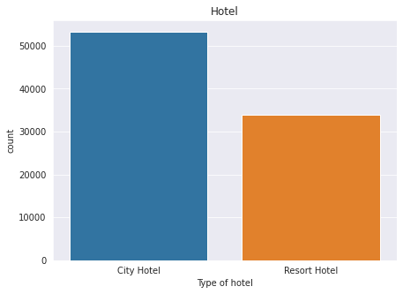
Univariate Analysis
Out of all bookings , 61% of bookings prefer the city hotel
39% of the bookings prefer the Resort Hotel.

Slide 9
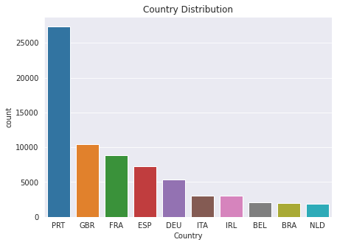
Univariate Analysis
82% of the total bookings come from 10 countries (i.e., Portugal, United Kingdom, France, Spain, Germany, Italy, Ireland, Belgium, Brazil and Netherlands).
Portugal is in 1st place in terms of bookings followed by United Kingdom and France.
Only Portugal (31%), United Kingdom (12%) and France (10%) contribute about 53% of total bookings

Slide 10
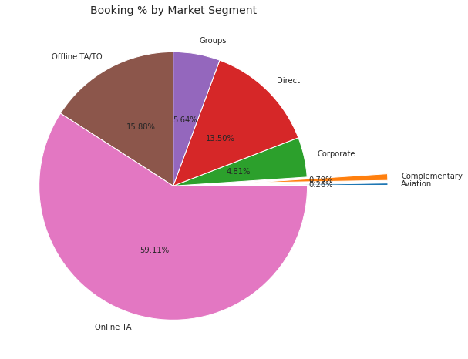
Univariate Analysis
Online TA has highest number of bookings, about 59.11% of total bookings are from Online TA.
Offline TA has the second highest bookings, about 15.9% of total bookings are from offline TA.
13.50% of Bookings are from Direct
5.6% of bookings are from Groups and 4.8% of bookings from corporate.

Slide 11
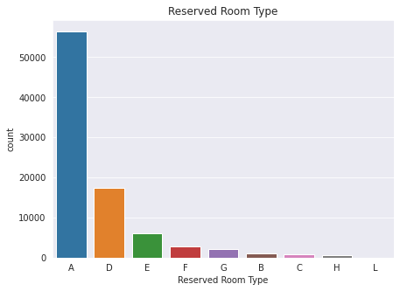
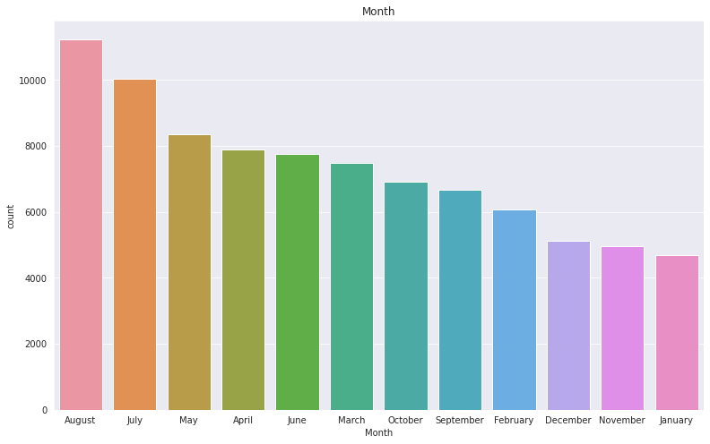
Univariate Analysis
Most of the bookings prefer rooms of Type A. About 64.7% of total bookings prefer room of type A.
Room type B is second most preferred room type with 19.62%
Highest number of bookings are in the month of August.
May to September are the most preferred months of the year.

Slide 12
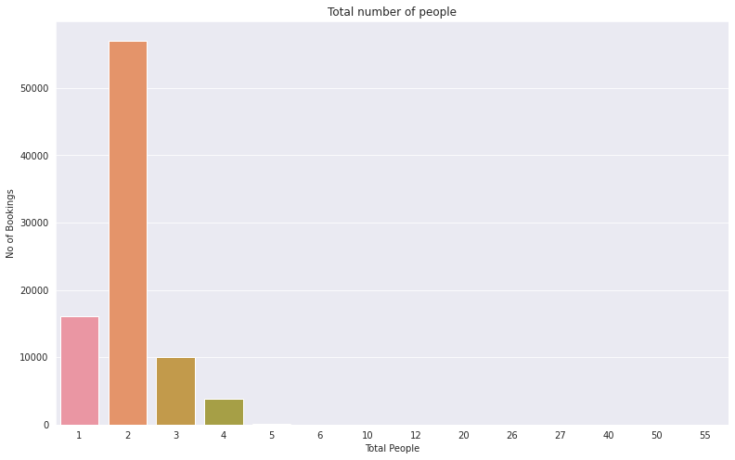
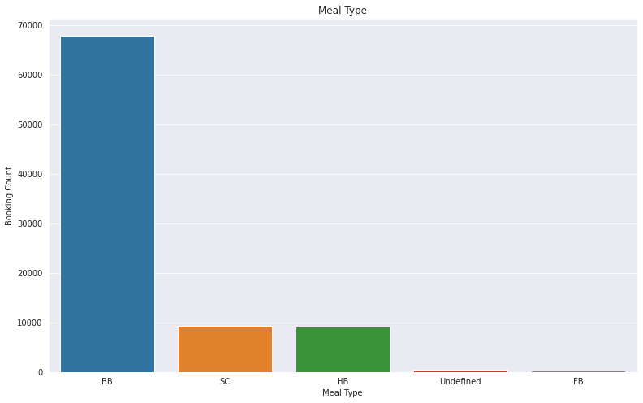
Univariate Analysis
More than 65% of the bookings are with total people as 2 i.e., nearly 2/3rd of the bookings are by couples.
The hotels can design more rooms for couples to accommodate as many as possible couple guests.
More than 75% of the guests opted for “BB” type of meal.
So hotels can plan to add more delicious dishes to attract more customers.
Also they have to take care of its quality to avoid losing customers.

Slide 13
Bivariate Analysis

Slide 14
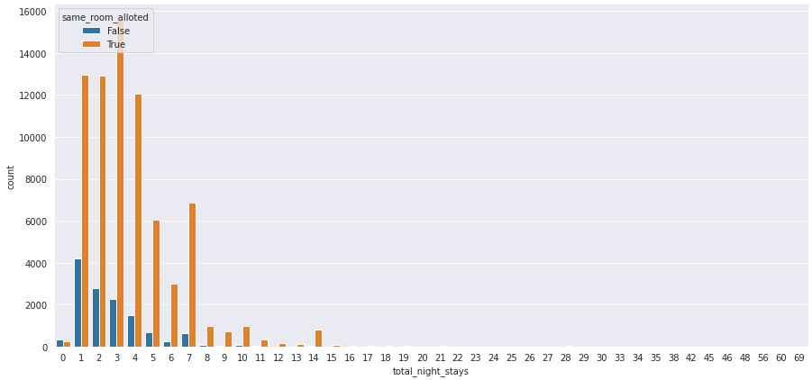
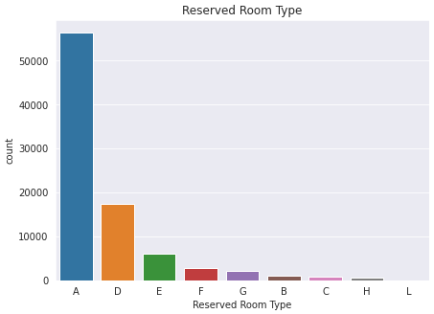
Bivariate Analysis
same_room_alloted
True
False
Customers tend to stay less longer in the hotel, if they are not allotted with the room they reserved.
As most of the customers are choosing room type ‘A’, hotels can plan to increase ‘A’ type rooms so that they can allot the same room that the customer has chosen and thus increase the stay duration of the customers in the hotel

Slide 15
Hotel wise Analysis

Slide 16
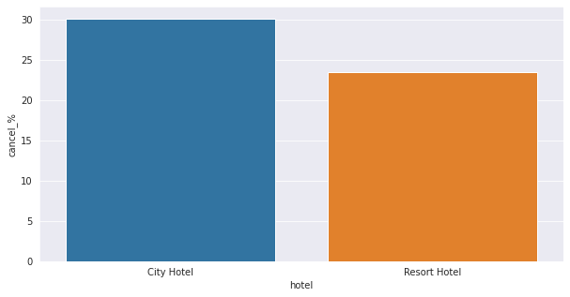
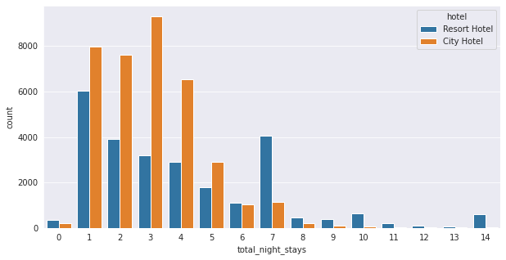
Hotel wise Analysis
Percentage of cancellation in City hotel is nearly 30%, whereas in Resort hotel it is around 23%.
Cancellation rate in City hotel is 30% more than that of Resort hotel
From the below chart we can observe that most of the people prefer to stay for 1 day in Resort hotel, whereas in City hotel more people prefer to stay for 1- 4 days.
We can also see a gradual decrease in count as no of nights stayed increases for Resort hotel and there is a sudden spike at no of days is equal to 7.
Very less people preferred to stay more than 5 days in City hotel

Slide 17
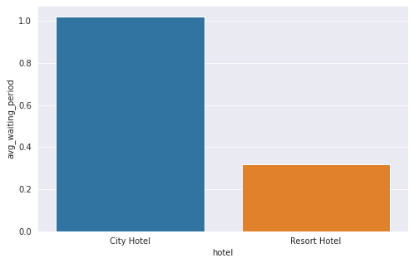
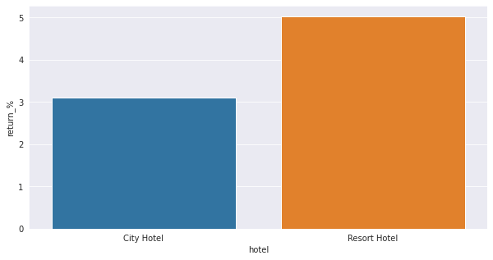
Hotel wise Analysis
The average waiting time for City hotel is 1 day but for Resort hotel it is only 0.3 days.
This might be because there are more no of bookings for City hotel compared to Resort hotel which resulted in higher waiting time.
For Resort hotel, 5% of the customers returned for another booking, whereas it is only around 3.01% for City hotel
So, the Resort hotel has 60% more customer repeat rate when compared to City hotel

Slide 18
ADR Analysis

Slide 19
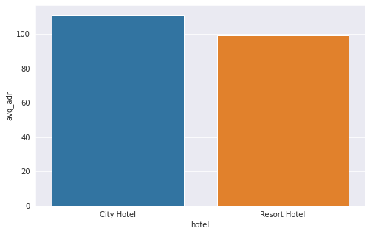
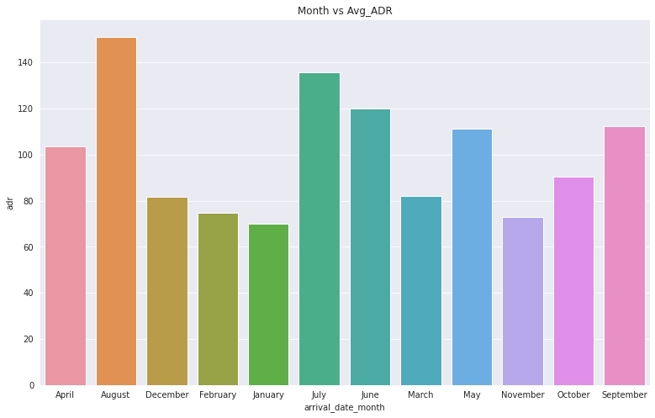
ADR Analysis
Average ADR of City hotel is 111.27 whereas for Resort hotel it is 99.05
City hotel has around 12% more Average ADR when compared to Resort hotel
Average ADR is high in period between May and September which is more than 110 in all these months
This may be due to summer season in Europe starts from May and it is best time to visit Europe. So more tourists may be visiting hotels.
So hotels can plan seasonal offers in that period to attract more customers

Slide 20
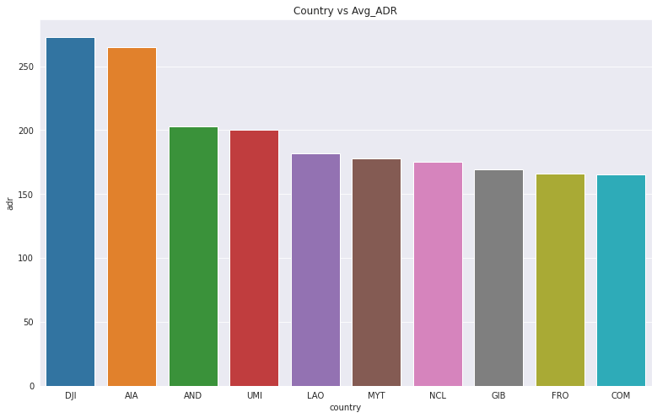
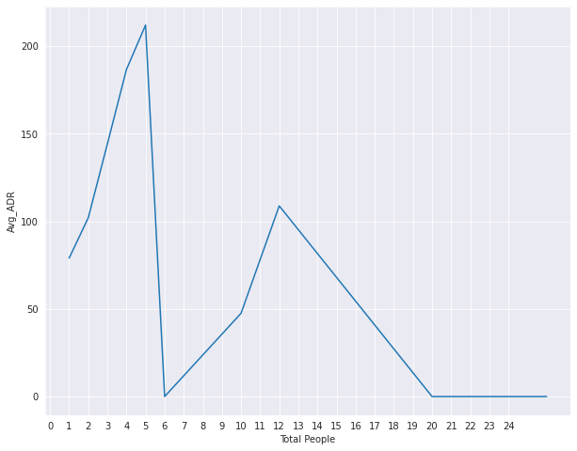
ADR Analysis
Top 10 countries that produced high average ADR are shown in the chart.
As these countries’ customers are producing higher ADR, the hotels can plan for better facilities or some complementary facilities to these customers
Average ADR is high when no of people is 5. May be when the customers come with family it produces high ADR.
So hotels can plan some benefits/offers to attract more family customers
We can see an increasing trend in Average ADR until total guests are 5 and from there a decreasing trend

Slide 21
Cancellation Analysis

Slide 22
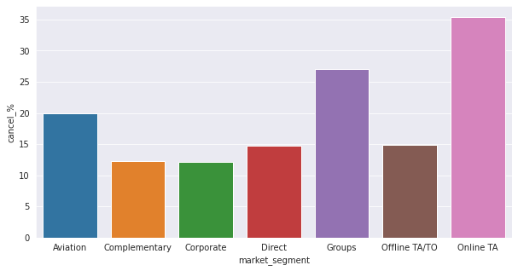
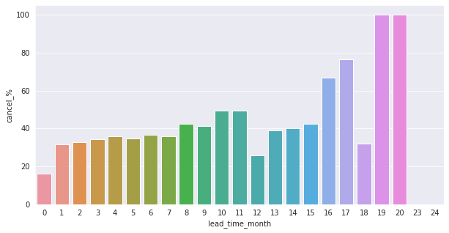
Cancellation Analysis
Cancellation percent is 35% from Online TA market segment i.e., more than 1/3rd of the cancellations are from this segment.
The Hotels can be strict on Online TA market segment in terms of cancellation
We can also see an increasing trend in cancellation percent as the lead time increases.
Cancellation percent is even 100% in case of lead time is 19 and 20 months.
The Hotels can reduce the maximum lead time to avoid more cancellations

Slide 23
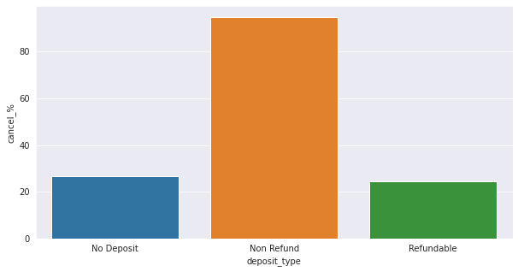
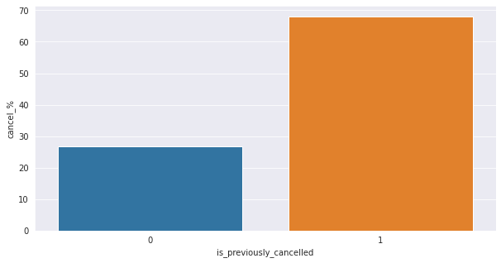
Cancellation Analysis
Surprisingly the cancellation percent is high in Non refund deposit type.
The hotels should closely go through the reasons for cancellation in this segment to understand the scenario and take remedies.
Cancellations are also high in the cases where the customer had previously cancelled a booking in the past.
The hotels can impose some extra rules on the customer if he/she has already cancelled a booking in the past to avoid more cancellations.

Slide 24
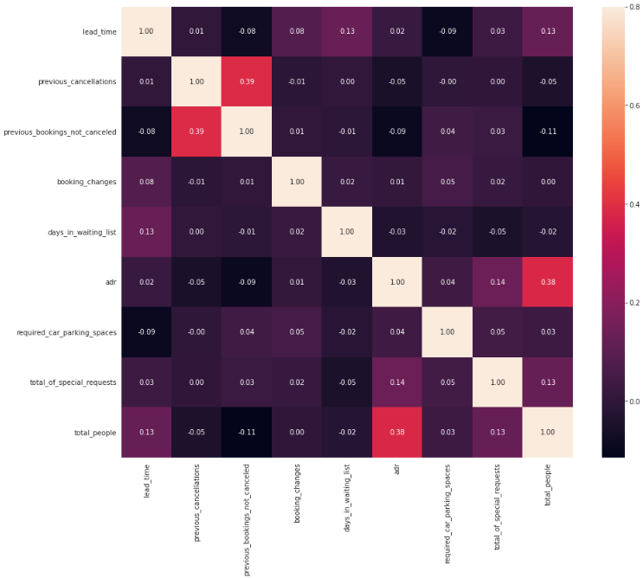
Correlation Heat Map
Previous_bookings_not_cancelled has slightly higher correlation with previous_cancellations as both are talking about cancellations.
ADR also has a little correlation with total_people which makes sense as more number of people means more revenue, hence more ADR.
Remaining all other numerical variables are not much correlated with each other.

Slide 25
Conclusions
Around 61% of bookings are for the City Hotel and 39% bookings are for Resort hotel, therefore City hotel is busier than Resort Hotel.
Most of the bookings are from European countries, so we need to focus more on Domestic market.
60% of the bookings are from Online TA and also 1/3rd of the total cancellations are from online TA. Some strict rule should be levied in terms of cancelations for online bookings.
Highest number of bookings are in the month of August and we can also see the increase in bookings in the month range from May to Oct. Hostel need to prepared for this peak time so they provide smooth experience for guests.
Guest tends to stay longer when they are allotted the same room type as they preferred while booking.
Avg. waiting time for City hotel is 1 day and for Resort hotel is 0.3 days. Resort hotel has 60% more customer return rate than City hotel, so city hotel should try to reduce the avg. waiting time.
Highest number of bookings are from people count of 2. Hotels need to provide good facilities and offers for couples to drive more traffic
Booking with people count as (4 – 5) has highest avg ADR. Focus more on families to increase revenue.
Lead time and cancelations are positively corelated.
Cancelations are more in non-refundable deposit type, hotel should check reasons for cancelations and take precautions.
Cancelation for previously canceled bookings is very high, so hotels can have strict policies for customers who had cancelled in the past.

